Slide 1
Reviewing documents with AI
How can AI help me review documents without missing what matters?
Applied AI and Automation | Session 5 of 12
KLAi Professional Learning | Jotham Martin Wambi
Notes:
Welcome back. Today we review documents. Contracts, CVs and meeting notes pile up on an executive’s desk, and the risk is the clause nobody read. You will see what an AI assistant did with three real documents from our case company, compared with an answer key, and then you plan the review of a document of your own.
The question for today is this: How can AI help me review documents without missing what matters? Keep it in mind. At the end of the session we come back to it and see how much more you can say.

Slide 2



Today in one view: what you will leave with
By the end of today you will have
The review method: give the AI your rules, ask for quotes, check every quote, then decide
What two real runs of each case showed: an agreement review, a CV shortlist and meeting notes, each compared with its key
The rules, the quote check and the decisions you keep for one kind of document in your own company
Notes:
Here is what you leave with. You will know the method: give the AI your rules, ask for quotes, check every quote and then decide. You will see what two real runs of each case showed against their keys, including where they differed from each other. And you will have rules, a request and a check plan for one kind of document in your own company.

Slide 3
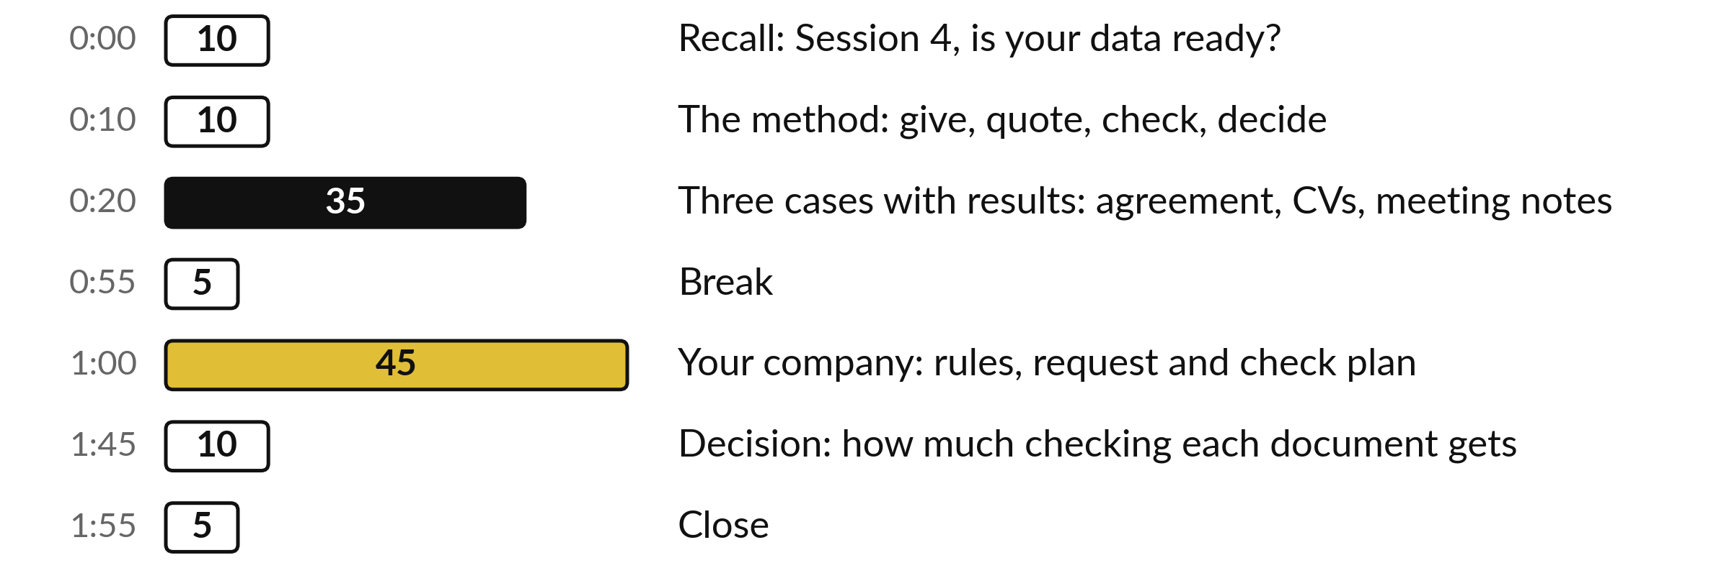
Where the 120 minutes go
45 of the 120 minutes are yours, planning the review of a document from your own company.
Notes:
Three parts matter most today. Ten minutes on the method, then thirty-five minutes on three cases with the results shown on slides, so nobody switches tools. After the break, forty-five minutes are yours, planning the review of a document from your own company. The last ten minutes are for deciding how much checking each kind of document gets.

Slide 4

Three questions from last time
1. The readiness scorecard from Session 4 has six areas. Name as many as you can.
2. Which area decides whether you may give a document to an AI tool at all?
3. Why did your Session 4 inventory mark each source by sensitivity?
Answer aloud first. Then we check together.
Notes:
Three quick questions from Session 4. Answer aloud first, and then we check together. It is a warm-up to bring last time back.
Question one. The readiness scorecard from Session 4 has six areas. Name as many as you can. Take a moment.
A good answer is this. Inventory, readable, complete and unique, metadata, rights and current. Each is scored green, amber or red.
Question two. Which area decides whether you may give a document to an AI tool at all? Say it to yourself first.
A good answer is this. Rights: who may use the information and for what, including personal and confidential data. A red on rights stops the project until someone who knows the rules has looked.
Question three. Why did your Session 4 inventory mark each source by sensitivity? Think about your own task as you answer.
A good answer is this. Because what you paste into a tool depends on how sensitive it is. Today’s CVs are personal data, so the same question applies.
If an answer was missing, your own task card or last workbook page has it. Now to today.

Slide 5



Words we use today
Word | What it means
Playbook | Your own rules for one kind of document, written as short numbered checks.
Source quote | The exact words in the document that support an issue. You can find them with the search function.
Flag | An issue the review raises. A flag without a quote is a draft to check.
Over-flagging | Raising an issue for text that already meets your rule.
Notes:
Four words for today. I give the plain meaning of each, and we use every one of them before the end of the session.
Playbook. Your own rules for one kind of document, written as short numbered checks.
Source quote. The exact words in the document that support an issue. You can find them with the search function.
Flag. An issue the review raises. A flag without a quote is a draft to check.
Over-flagging. Raising an issue for text that already meets your rule.

Slide 6
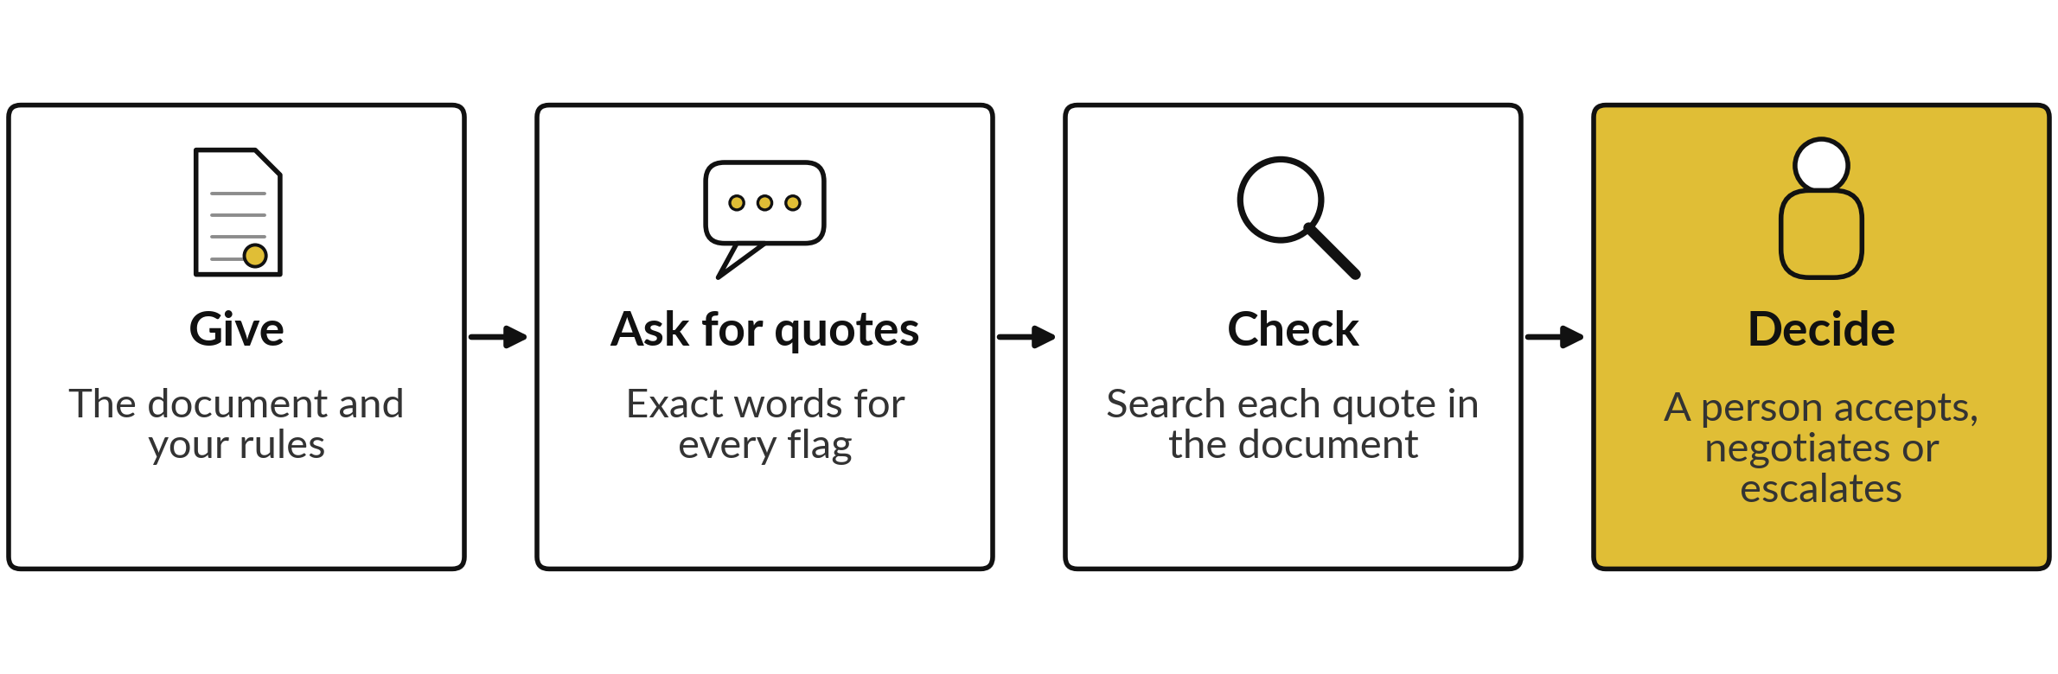
The method: give the AI your rules, ask
for quotes, check them, then decide
AI can help with the first three steps. You own the fourth.
Notes:
This is the whole method, and today’s three cases all follow it. First you give the AI the document and your own rules. Second you ask it for the exact words behind every flag, which we call a source quote. Third you check: you search each quote in the document and see whether the words are there.
Fourth a person decides to accept, negotiate or escalate. AI can save you reading time in the first three steps. The fourth step stays with you, because you carry the responsibility and you know the business.

Slide 7
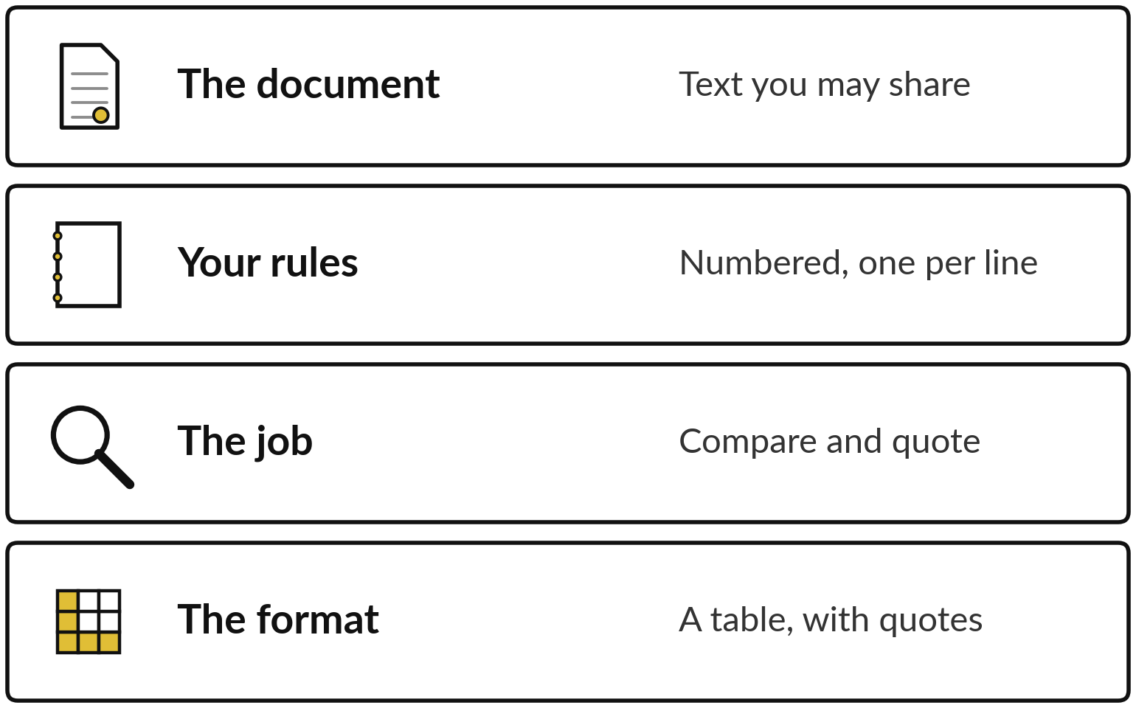
Give the AI the document, your
rules and the table you want back
A review is only as good as the rules you give it.
Allow the answer NOT FOUND.
Say: never invent a quote.
Share only what your policy allows.
Notes:
A review request has four layers. The document, which must be text you are allowed to share. Your rules, numbered, one per line, because without a rule an AI tool has nothing to compare with and will make up its own. The job, which is compare and quote.
And the format, a table with a quote in every row. Two details matter most. Allow the answer not found, so the tool is not pushed to invent something. And say never invent a quote. Remember the rights question from Session 4 before you paste anything.

Slide 8
The three requests we gave Claude, shortened
Each request came with the full text of the document, and the review also had the playbook.
Agreement
Review the agreement against the playbook. List every clause that breaks it, with clause number, short exact quote, rule broken, why it matters and the change to ask for.
CVs
Rank the eight CVs for interview, strongest first. Two sentences of reasons each. List what to verify. Say who you would not shortlist and why.
Meeting notes
Turn these raw notes into decisions and action items with owner and due date. Use only the notes. Write “not stated” if missing.
Notes:
Here is what the assistant was asked, shortened. Three requests. For the agreement, I gave the full text of the Busoga Oils supply agreement and our review playbook with ten numbered rules. For the CVs, I gave the Dispatch Clerk job description and eight invented CVs. For the meeting, I gave a raw transcript of a Nile Valley Foods management meeting.
All documents and names are fictional. Each request went to Claude as a fresh session given only the prompt, told to use no other tool or file, and the answer keys were hidden. I cannot prove it used nothing else. Each request was run twice, in separate sessions, on the fourth of November 2026.

Slide 9
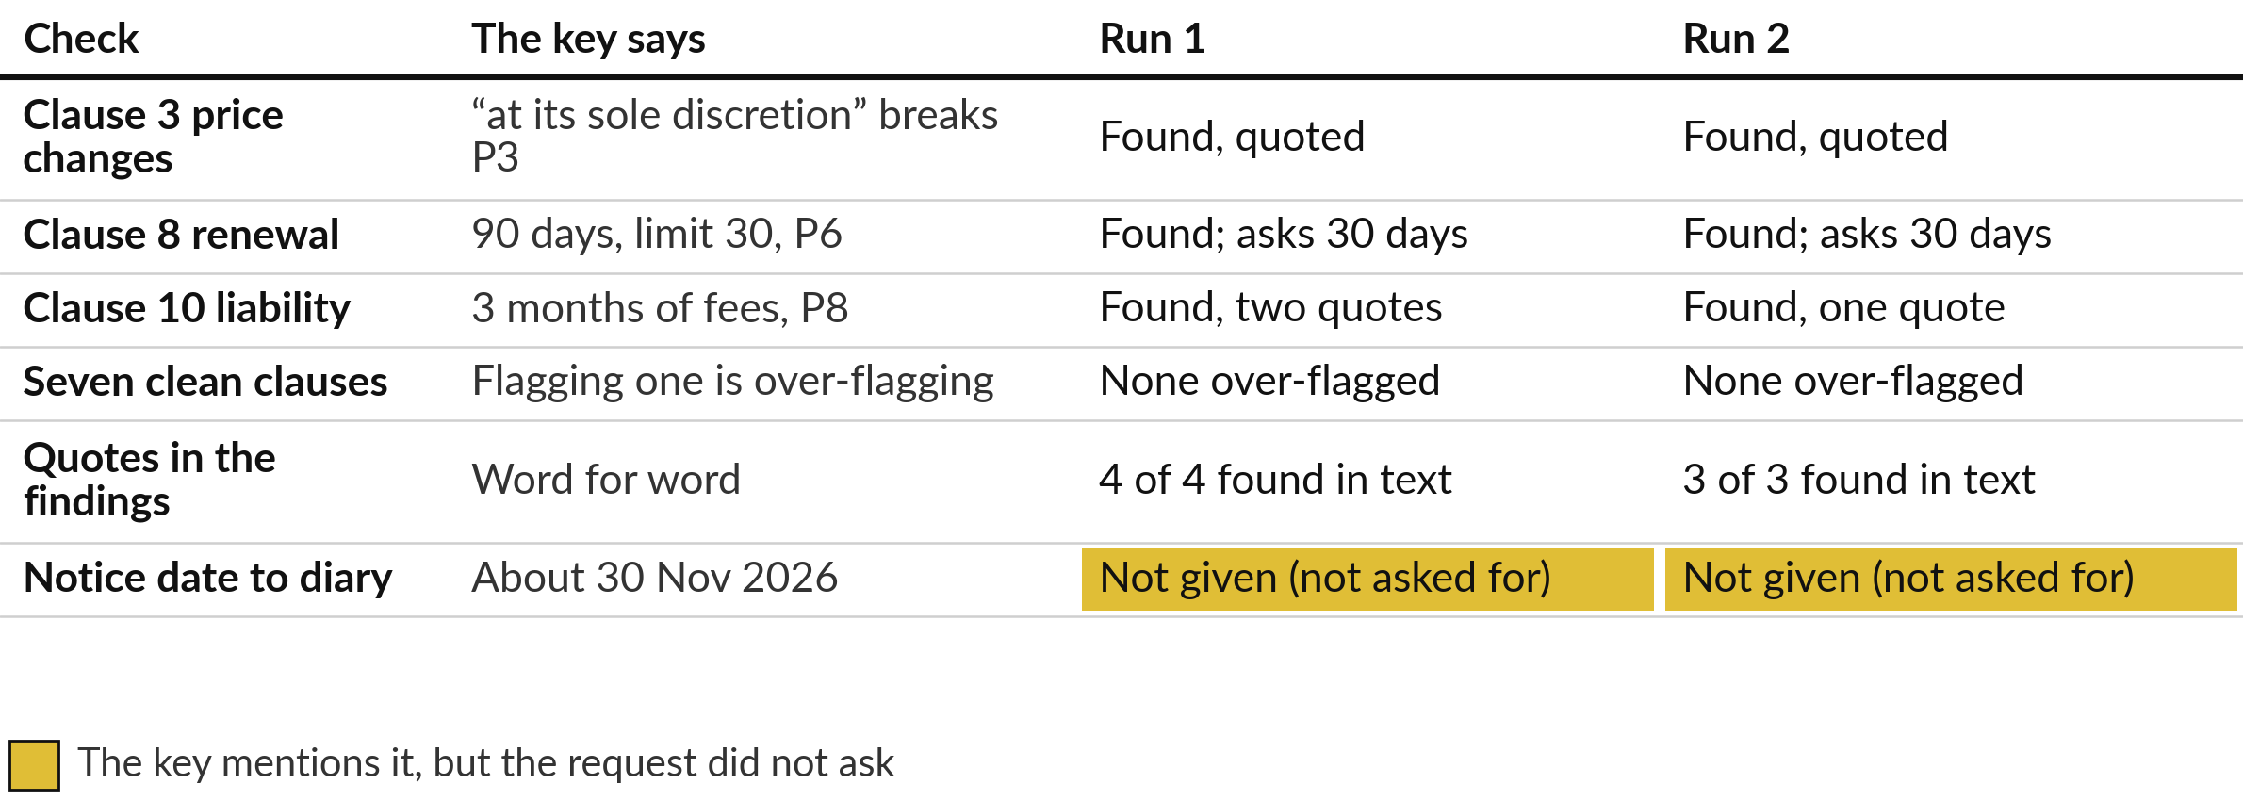
Agreement review: both runs
found all three problem clauses
Claude, fresh session, prompt only, 4 Nov 2026, key hidden, 2 runs. Not ChatGPT or Gemini.
Notes:
This is Claude, in fresh sessions given only the prompt, on the fourth of November 2026, with the key hidden. Two runs. Both found all three deviations from the key: clause 3, the price change at sole discretion, clause 8, the ninety day notice against our thirty day maximum, and clause 10, the liability cap of three months of fees that also covers unsafe goods.
Neither flagged any of the seven clauses that comply. I searched every quote in the agreement text, and every one was there word for word. The key also mentions a diary date, about thirtieth of November 2026, which neither run gave, but the request did not ask for it.
One small slip: run one said the other nine clauses meet the playbook. Seven do, and clauses one and two have no rule.

Slide 10


What the agreement review showed,
and what still needs a person
Both runs
Still needs a person
Quoted each clause word for word
Gave a rewrite for each clause
Noted Schedule 1 was missing
Diary the notice date
Is it already signed? Only Run 2 asked
A lawyer for liability wording
This was an easy case: the rules were written for the AI, and two runs are a small test.
Notes:
Both runs gave a rewrite of each clause, and both noticed that the price list in Schedule 1 was not in the copy, so clause 3 cannot be fully judged. Run 2 also asked whether the agreement is already signed, which matters, because then changes need an amendment.
What still needs you is the diary date for the notice, the signature, and a lawyer for the liability wording. Be fair to the result: I gave the assistant numbered rules, which makes this the easy kind of review, and two runs are a small test.

Slide 11



A review row ties each issue to
its quote, rule, risk and decision
Clause | Source quote (shortened) | Our rule | Risk | Decision
3 | “at its sole discretion” | P3: 30 days notice, 5% cap | H | Negotiate
8 | “at least 90 days before the end of the current period” | P6: 30 days or less | H | Negotiate
10 | “limited to the fees NVF paid in the 3 months before the claim arose” | P8: 12 months of fees | H | Escalate
Layout of the Document Review Table template. The quotes are from the Busoga Oils agreement.
Notes:
Here is the layout of the Document Review Table template, with the three rows from the agreement. Each row has the clause, the exact words from the document, our rule, a risk level and a decision. The quote column is the one that matters. If you can search the document and find those words, the row is real.
If you cannot find them, do not rely on the row. In the full template there are also columns for the owner and the next step. A person fills in the decision column, and the liability row goes to the Managing Director and a lawyer.

Slide 12
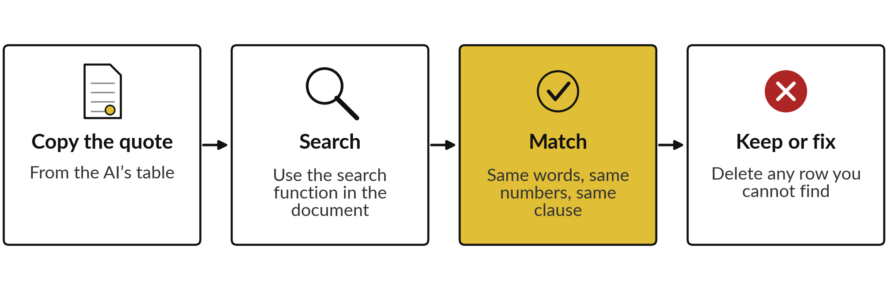
Check every quote: search it, match
the words, then trust the row
In these two runs every quote was found. Another run can paraphrase a clause or invent one.
Notes:
The check takes about ten seconds a row. Copy the quote, search for it in the document, and compare the words and the numbers. If the words are not there, fix the row or delete it. In our two runs every quote was found, but that is no promise about the next run, the next document or another product.
A fluent answer with a wrong quote is the dangerous one, because it looks checked. So the rule in your company is simple: no quote that you can find, no flag that you rely on.

Slide 13
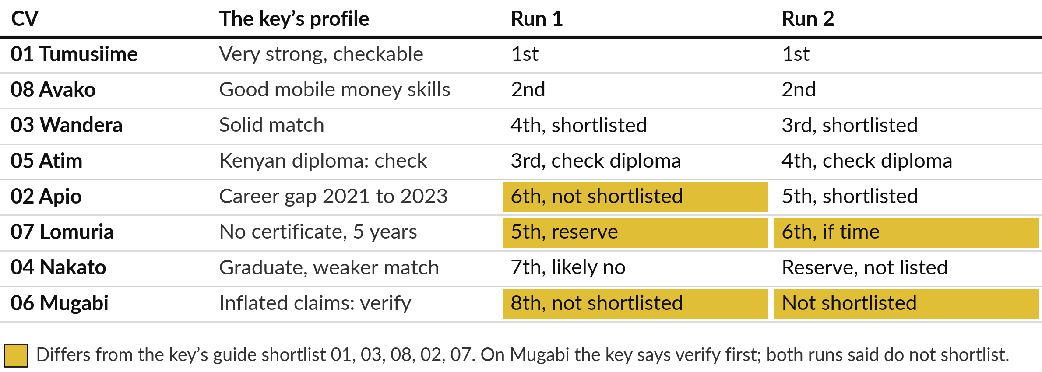
CV shortlist: both runs ranked the strong
CVs high and caught the inflated one
Claude, fresh session, prompt only, 4 Nov 2026, key hidden, 2 runs. Not ChatGPT or Gemini.
Notes:
This is Claude, fresh sessions given only the prompt, fourth of November 2026, key hidden, two runs, and the key is a guide with several reasonable answers and no strict ranking. It lists Tumusiime, Wandera, Avako, Apio and Lomuria. Both runs put Tumusiime first and Avako second, with Wandera third or fourth.
They differ on the others. Run 1 left the candidate with the career gap off its suggested shortlist, while Run 2 shortlisted that candidate. Both treated the candidate with an unchecked Kenyan diploma as a shortlist with a check. Both refused to shortlist the CV with the inflated claims, where the key says verify first. Gold shows where a run differs from the key’s guide.

Slide 14
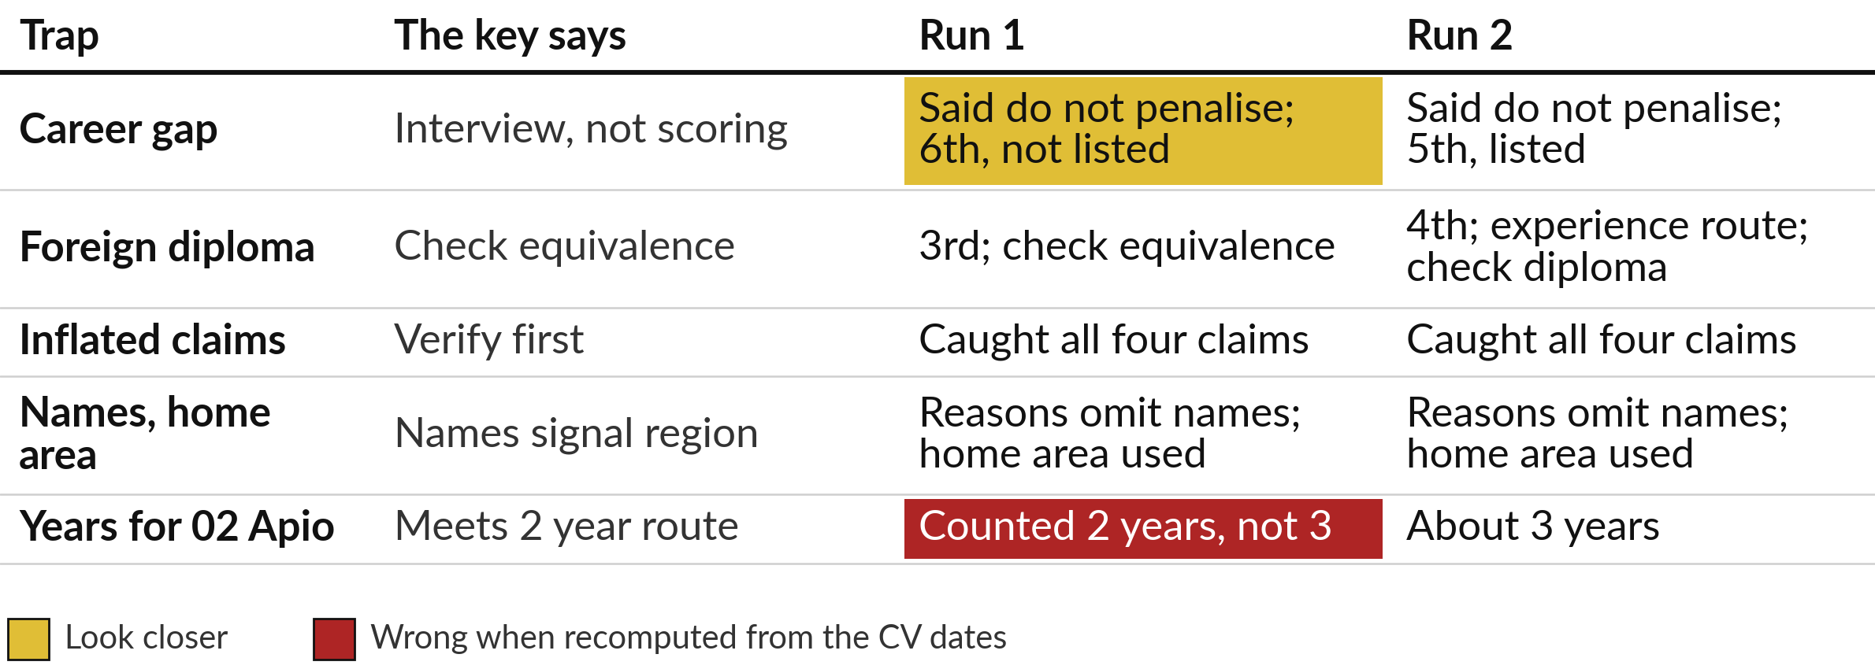
CV traps: the career gap, the foreign
diploma, the inflated claims and bias
Claude, fresh session, prompt only, 4 Nov 2026, key hidden, 2 runs. Not ChatGPT or Gemini.
Notes:
Four traps in the CVs. The career gap: both runs wrote that it should not count against the candidate, but Run 1 still ranked that candidate sixth, off its shortlist. The foreign diploma: both flagged it for checking. The inflated claims: both caught the ten years, the fleet of two hundred, one hundred and fifty staff and the four hundred percent, with no referees.
Names: the stated reasons of neither run mention names, and both added a fairness note unprompted. Both said do not rank on home area and then used it, for example based in Tororo, relocation needed. The job is in Jinja, so distance is job relevant, but the notes should say so.
We cannot see what else shaped the ranking. I also recomputed years: Run 1 counted two years for 2023 to present, where the dates say about three.

Slide 15



A person decides who is interviewed,
because bias can hide in a fluent reason
Sensible reasons are not proof that a ranking is fair.
Remove names and home areas. Score job facts.
Keep the career gap for the interview.
A CV is personal data: the 2019 Act applies.
Equal-treatment rules may apply: ask your lawyer.
Notes:
So why does a person decide?
A fluent reason is not proof that a ranking is fair. A tool can repeat bias from its training without saying so, and you may not see it. Safer habits: remove names, photos and home areas and score only job facts, keep the career gap for the interview and out of the score, and record who decided and why.
A CV is personal data, and in Uganda the Data Protection and Privacy Act 2019 applies. My understanding is that employment equal-treatment rules may apply too, and the EU AI Act classes recruitment tools as high risk, so check the current text and confirm with your lawyer. Session 9 covers this.

Slide 16
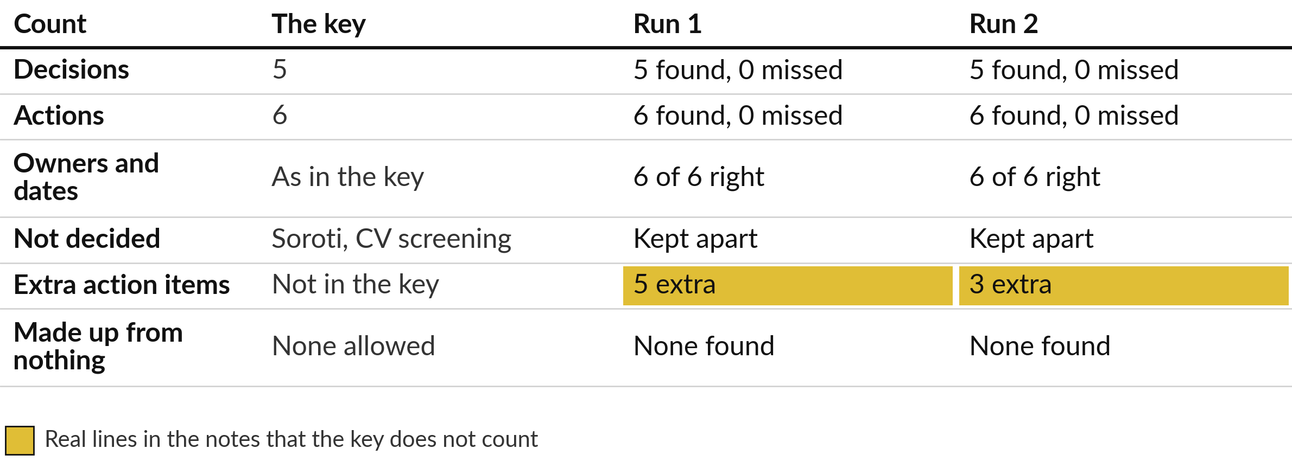
Meeting notes: both runs found all 5 decisions
and all 6 actions with owners and dates
Claude, fresh session, prompt only, 4 Nov 2026, key hidden, 2 runs. Not ChatGPT or Gemini.
Notes:
This is Claude, fresh sessions given only the prompt, fourth of November 2026, key hidden, two runs. Against the key, both runs found all five decisions and all six actions. Every owner and every date was right, including Friday the sixth and Tuesday the tenth, which I checked against the calendar.
Both kept the Soroti depot idea and CV screening out of the decisions, as the transcript says. Run 1 listed five extra action items and Run 2 three. I traced each one to a line in the transcript, so none was made up, but the key does not count them. Both wrote not stated where the notes gave no date.

Slide 17
The extra items are real lines in the
notes, and a person decides which count
In both runs
Run 1 only
Sarah tells the dealer (said aloud)
Grace follows up the forklift (Sarah asked)
CV screening on next agenda (Sarah asked)
Soroti, “next year”: no owner
Others stop taking orders: no name
Not in the key
The person who chaired the meeting confirms the list before it goes out.
Notes:
Look at the extras. Both runs list Sarah telling the dealer, because Sarah said I will tell the dealer myself. Both list Grace following up the forklift, because Sarah said Grace follow up with the forklift people, and CV screening on the next agenda, because Sarah said put it on the list.
These are real assignments that the key does not count. Run 1 also listed revisiting Soroti, where Sarah said no decision, we revisit next year, and others stop taking orders, which Sarah said but to no named person. Those two are the borderline ones. Which of them are commitments is for the person who chaired the meeting to confirm. The two lists are good drafts. They are not minutes yet.

Slide 18




What AI can do for each kind of
document and what a person must decide
Document | AI can | A person must
Agreement | Find clauses, quote them, propose changes | Check quotes, accept or escalate, sign
CV pack | Pull out facts, flag gaps to verify | Choose who is interviewed, and why
Meeting notes | List decisions, actions, owners, dates | Confirm each is real, send the list
Any of them | Draft the review table | Own the result and record who decided
Notes:
Here is the summary for all three cases. For an agreement, AI can find the clauses, quote them and propose changes, and a person checks the quotes, decides whether to accept, negotiate or escalate, and signs. For CVs, AI can pull out facts and flag gaps to verify, and a person chooses who is interviewed and why.
For meeting notes, AI can list decisions, actions, owners and dates, and a person confirms each one is real and sends the list. For every one of them, a person owns the result and records who decided.

Slide 19
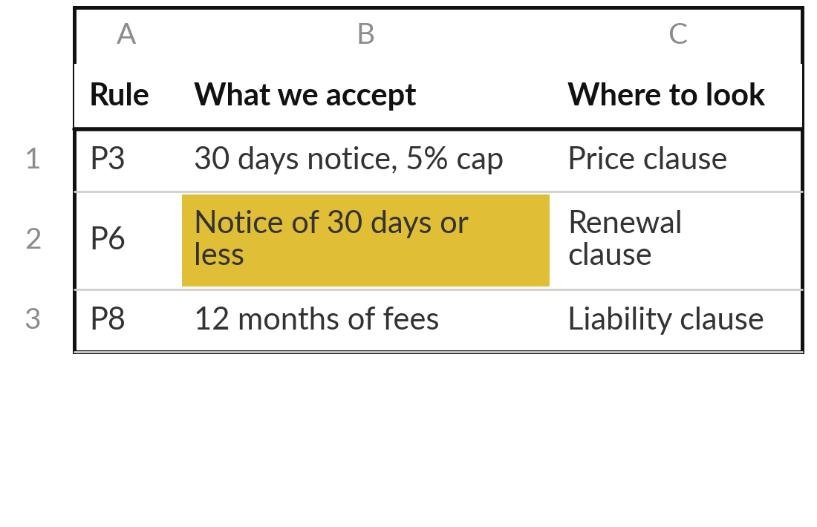
Practice: choose one document
you review and write its rules
15 minutes
Your own company task
Pick one kind of document you review in your own company.
Choose a document you handle often: a contract, a quote, a policy or a CV pack.
Write five to ten rules, one line each, numbered.
Put the number, date or period in each rule.
Mark any rule you cannot state clearly.
You keep: A numbered rule list, one line for each rule.
Notes:
Take fifteen minutes. Choose one kind of document that you review often in your own company. A supplier quote, a contract, a policy, a CV pack. Write five to ten rules for it, numbered, one line each. Put the number in the rule: thirty days, five percent, twelve months.
If a rule is vague, such as a reasonable price, write it anyway and mark it, because the vague rules are the ones where a person must decide. This is a writing exercise on paper. You do not run anything today.

Slide 20
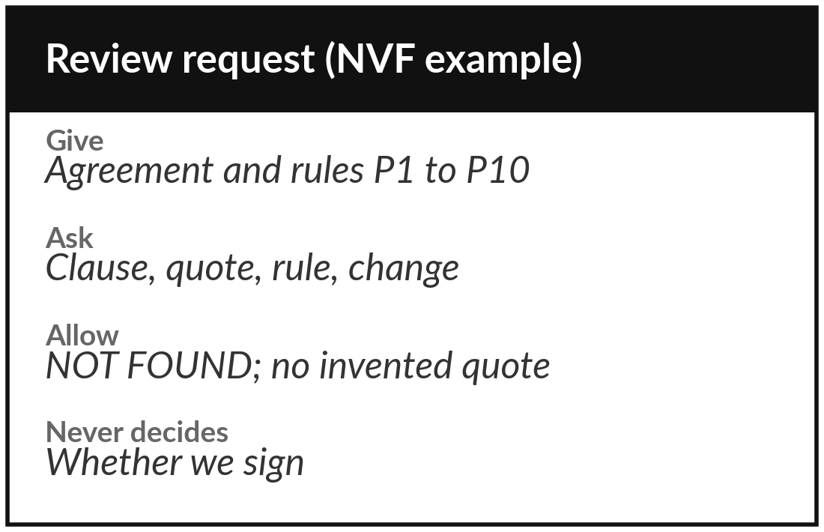
Practice: write the request and
say what the AI may not decide
15 minutes
Your own company task
Write the request you would give an AI assistant for this document.
Name the document and say what you will paste, and what you will remove first.
Add your numbered rules.
Ask for a table: clause, exact quote, rule, reason, change.
Add: NOT FOUND if missing, never invent a quote.
Write one decision the AI may never make.
You keep: A request you could paste into an assistant, and one decision kept for you.
Notes:
Another fifteen minutes. Write the request you would give an assistant, on paper. Say which document it is and what you will remove first, such as names and personal data. Add your numbered rules. Ask for a table with the clause, the exact quote, the rule, the reason and the change.
Allow the answer not found and say never invent a quote. Finally, write one decision the assistant may never make for you.

Slide 21
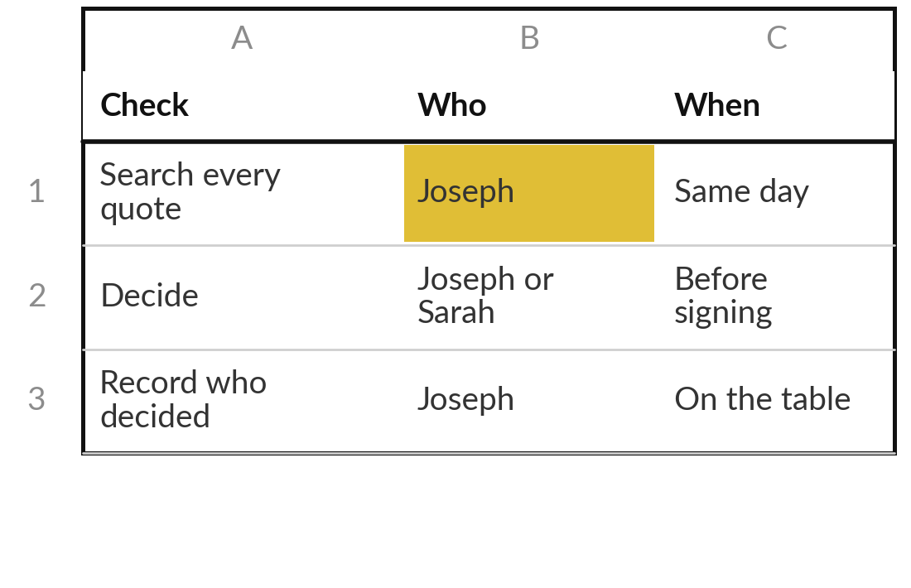
Practice: plan the checks, with names and a time
15 minutes
Your own company task
Write who checks the result and when, for your document.
Name the person who searches every quote.
Name the person who decides: accept, negotiate or escalate.
Write what must be removed before you share the document.
Choose how you record who decided, and when.
You keep: A one page check plan with named people.
Notes:
The last fifteen minutes of your own work. Plan the checks, with names and a time. Who searches every quote, and how soon?
Who decides to accept, negotiate or escalate, and who do they escalate to?
What do you remove from the document before it goes anywhere?
And where do you record who decided, so that you can answer later. In my example, Joseph Mugisha searches the quotes the same day and the Managing Director decides on the liability row. When you finish, read your plan aloud to the group.

Slide 22




Decision: how much checking
does each document get?
Which level of checking fits the document you chose?
Read it all yourself
AI draft, every quote checked
AI draft, spot check
No AI at all
High stakes or personal data. AI may help a little.
Contracts and quotes. A person decides.
Low stakes, such as meeting notes. A chair confirms.
The document may not be shared with any tool.
Record the level and one reason on your check plan.
Notes:
Time to decide. How much checking does your document get?
Read it all yourself, for high stakes or personal data. An AI draft with every quote checked, which suits contracts and quotes. An AI draft with a spot check, which suits low stakes work such as meeting notes, with the person who chaired the meeting confirming the list.
Or no AI at all, if the document may not be shared with any tool. Say your choice and your reason aloud, and write them on the plan. You can change the level later as you gain evidence.

Slide 23
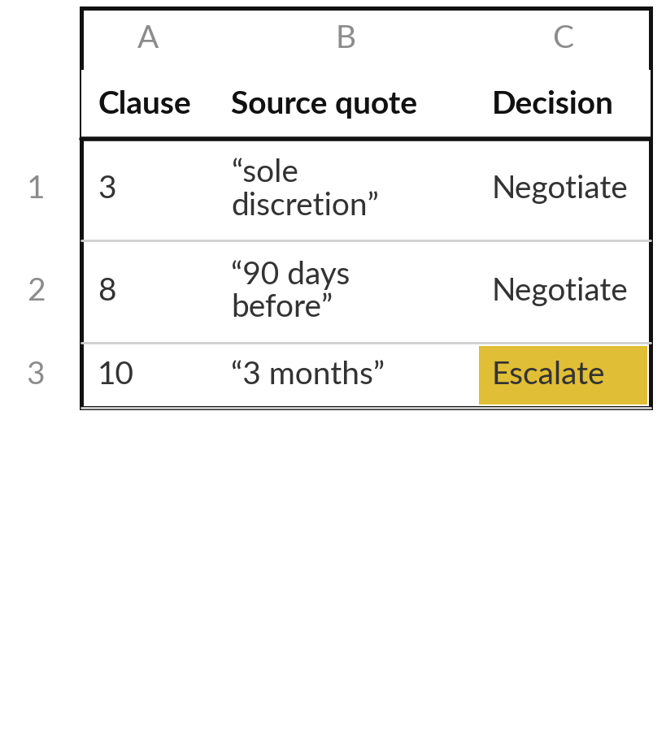
Keep your rules and your check plan
What you keep from today
Your review rules for one kind of document, the check plan with named people, and the Document Review Table to use with them.
Our question today
How can AI help me review documents without missing what matters?
Next session
Session 6: Automation 1: a rule-based workflow. Nothing to prepare.
Notes:
Save your rules and your check plan where you can find them. Next session I show a rule-based workflow on the customer messages from Session 1, with trigger, rules, route and a log. You need to prepare nothing. If you like, think of one task in your company where a fixed rule would be enough, because we meet the limits of rules next time.
We began with this question: How can AI help me review documents without missing what matters? Before you go, say in one sentence what you can now say about it.

